Slide 1


Zijie Mei
01/17/2024

Slide 2

Outline
Executive Summary
Introduction
Methodology
Results
Conclusion
Appendix

Slide 3
Executive Summary
For this project, I used API and webscraping to collect data, then cleaned the data. After that, I did exploratory data analysis with both SQL and visualization. Furthermore, I created interactive dashboard with folium and dash. In the end, develped machine learning models to classify outcomes of different launches across the years.
Key Findings:
I was able to find a good Decision Tree model with 84% in samle accuracy and 83% test accuracy that can effectively predict the launch outcomes.
I found out that successful rate is going up over the years.

Slide 4
Introduction
Background:
Space X advertises Falcon 9 rocket launches on its website with a cost of 62 million dollars; other providers cost upward of 165 million dollars each, much of the savings is because Space X can reuse the first stage. Therefore if we can determine if the first stage will land, we can determine the cost of a launch. This information can be used if an alternate company wants to bid against space X for a rocket launch.Problems you want to find answers
Objective:
Provide valueble informations to my company SpaceY, which is to build machine learning models and use public informations to predict if SpaceX will reuse the first stage in order to determine the price of each launch.
Develop dashboards that provides informations about SpaceX that can used by my team.

Slide 5

Section 1

Slide 6
Methodology
Executive Summary
Data collection methodology:
Data was collected by using SpaceX API and webscraping data from Wikipedia table
Perform data wrangling
Some innitial exploration of the data and identified missing values as well as creating label column
Perform exploratory data analysis (EDA) using visualization and SQL
Perform interactive visual analytics using Folium and Plotly Dash
Perform predictive analysis using classification models
Trained various models through cross validation to find the best parameters

Slide 7
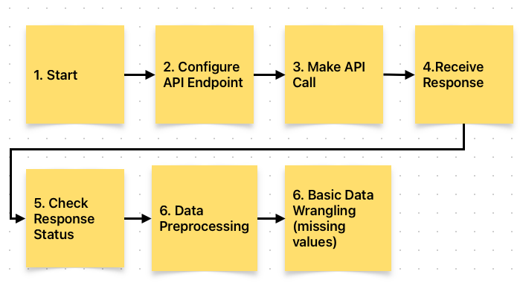
Data Collection – SpaceX API
The picture on the right shows the flowcharts of the API data collection, and below is a hyper link to the github code.
GitHub Link
Place your flowchart of SpaceX API calls here

Slide 8
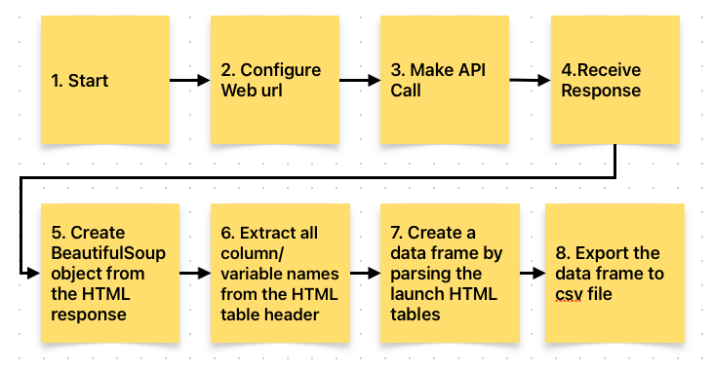
Data Collection - Scraping
The picture on the right shows the flowcharts of the Scraping of the data collection stage, and below is a hyper link to the github code.
GitHub Link
Place your flowchart of web scraping here

Slide 9
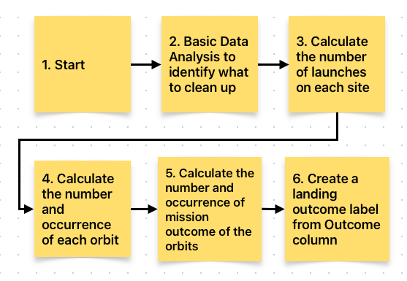
Data Wrangling
The picture on the right shows the flowcharts of the Scraping of the data collection stage, and below is a hyper link to the github code.
GitHub Link

Slide 10
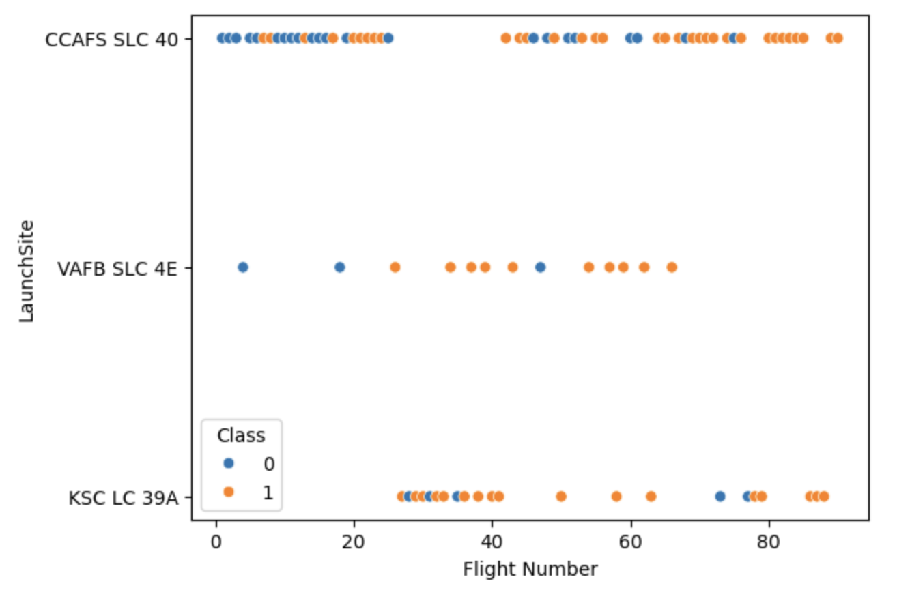
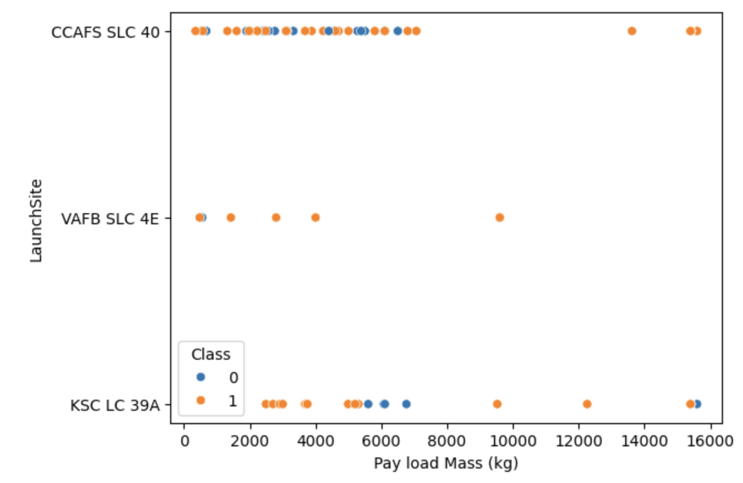
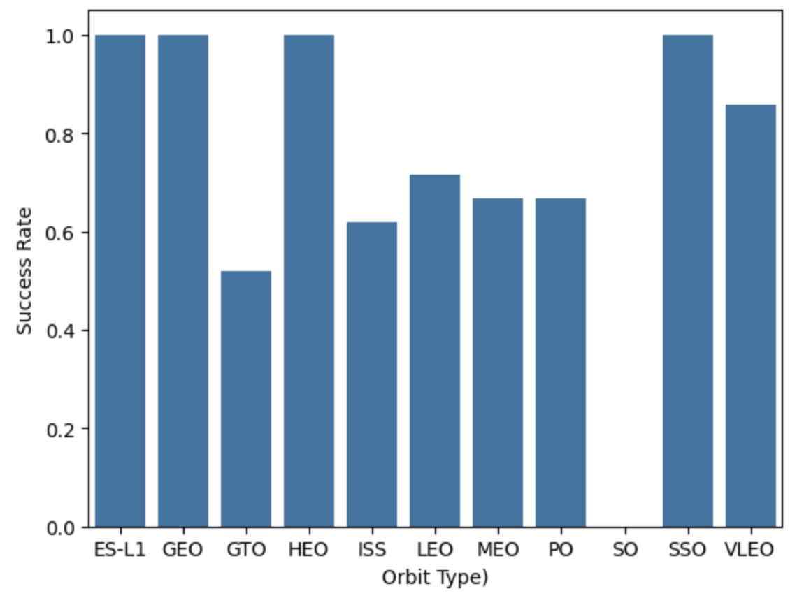
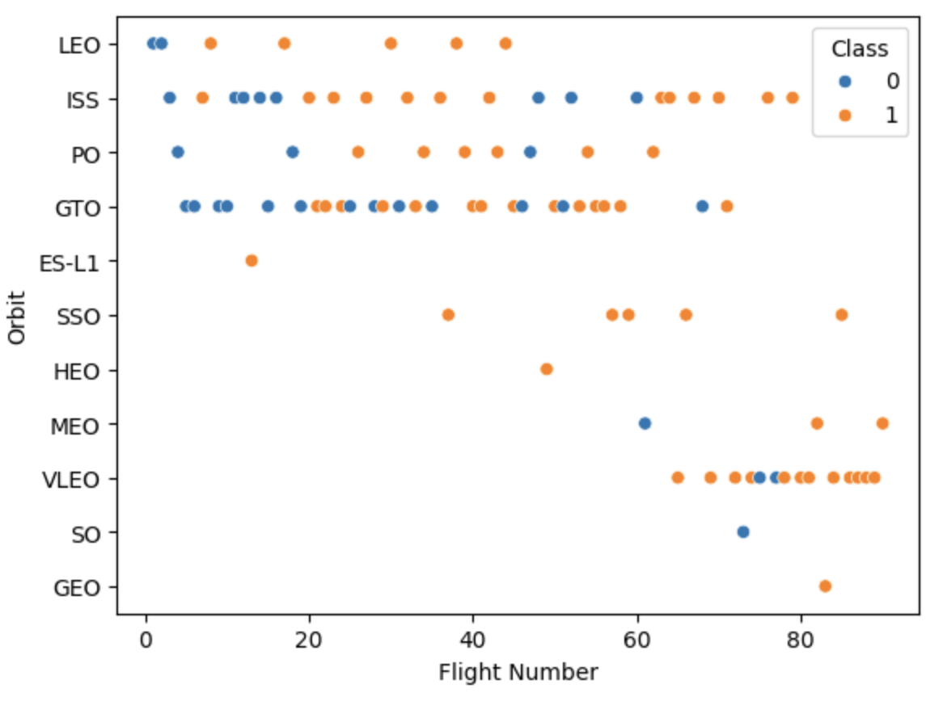
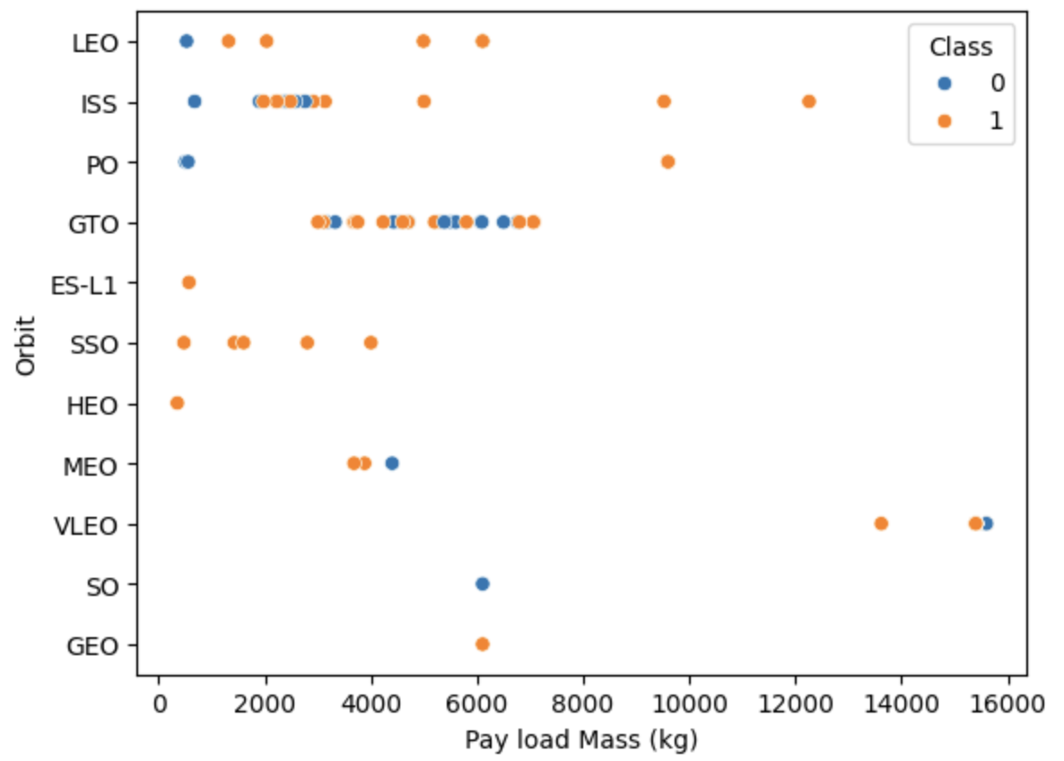
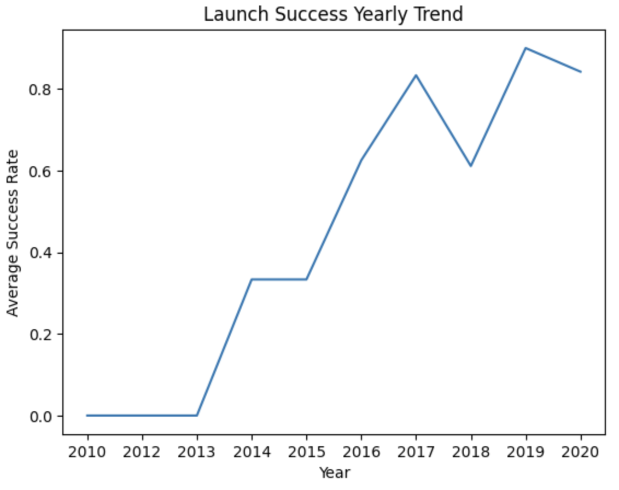
EDA with Data Visualization
VAFB SLC 4E has the least flight numbers associated with it.
VAFB SLC 4E appears to alwasy have low payload mass.
SO and GTO has the least success rate.
GTO has a lot of launches with low payload mass
Average success rate has gone up over time.
ES-L1, GEO and SO only has one Flight Number associated with it.
GitHub Link

Slide 11
EDA with SQL
Found unique launch sites in the space mission.
Found 5 records where launch sites begin with the string ‘CCA’
Total payload mass by NASA(CRS): 45596kg
Average payload mass carried by booster version F9 v1.1: 2534.7 kg
First succesful landing outcome in ground pad was in 2015-12-22
Found the names of the boosters which have success in drone ship and have payload mass greater than 4000 but less than 6000
Found the total number of successful and falure mission outcomes: 71
Found all the names of the booster versions which have carried the maximum payload mass.
Found 2 failure landing_outcomes in drone ships in 2015.
Ranked the count of landing outcomes between the date 2010-06-04 and 2017-03-20
GitHub Link

Slide 12
Build an Interactive Map with Folium
Added all launch sites on the map to show where they are.
Added launch count for each launch site.
Color coded all successful or failure landings with each launch.
Made a line from CCAFS LC-40 launch site to the nearest coast line and calculated and marked the distance.
GitHub Link

Slide 13
Build a Dashboard with Plotly Dash
I only added one dropdown list where options can be picked out of ALL or every launch site.
Added a pie chart to show the total successful launches count for all sites.
The pie chart can also show success vs. failed counts for the selected launch site.
Added a slider to select payload range.
Added a scatter chart to show the correlation between payload and launch success based on the dropdown pick and the slider range
GitHub Link

Slide 14
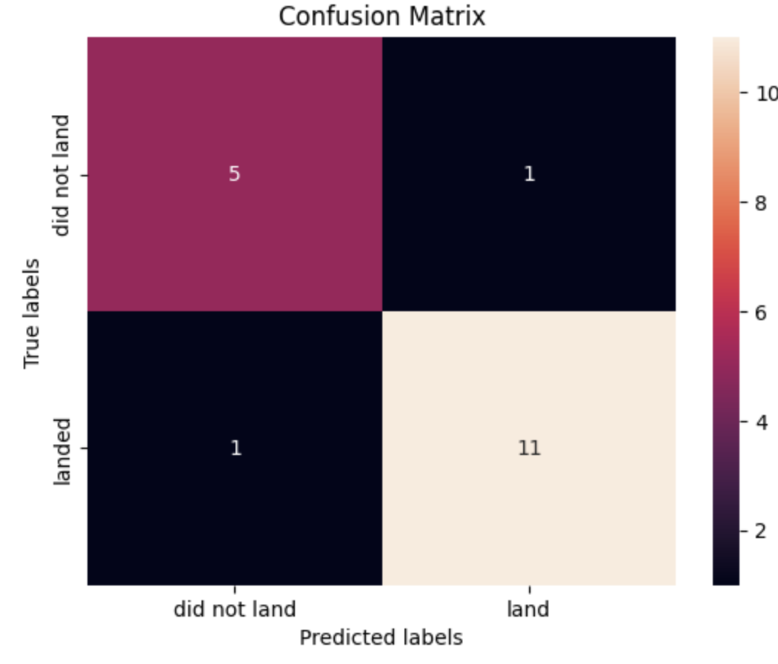
Predictive Analysis (Classification)
I prepared the data, standardized the features, and splitted data into 80% training and 20% validation, then used cross validation to find the best parameter for each model and eventually compared validation accuracy and confusion matrix for each model to get the best performing model.
The best perfoming model is decision tree because it has the best confusion matrix since true positive and true nagative is balanced with the best performing out of sample accuracy of 83.3%
GitHub Link

Slide 15
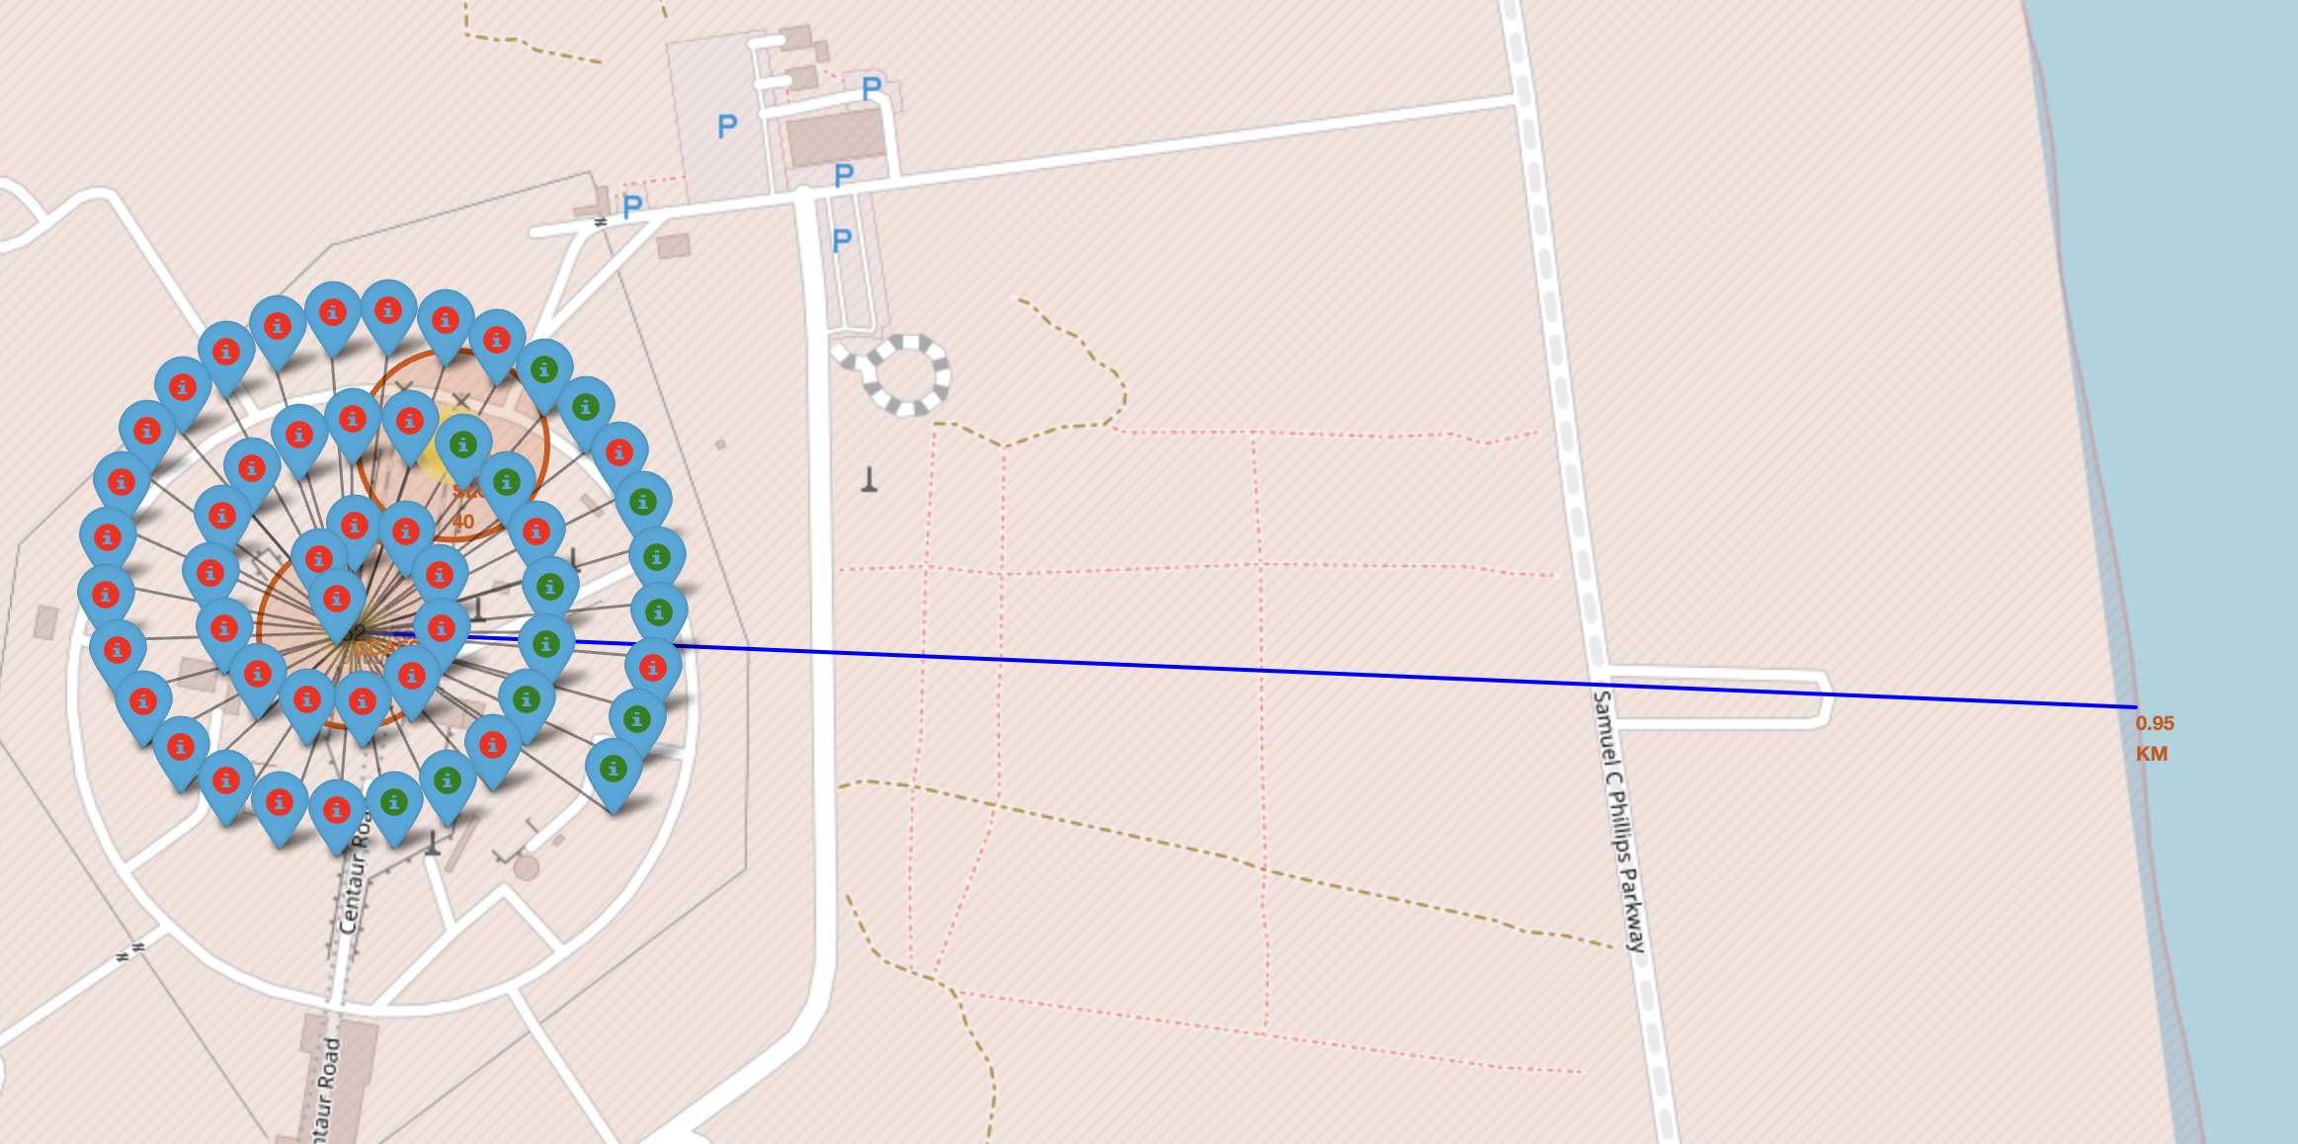
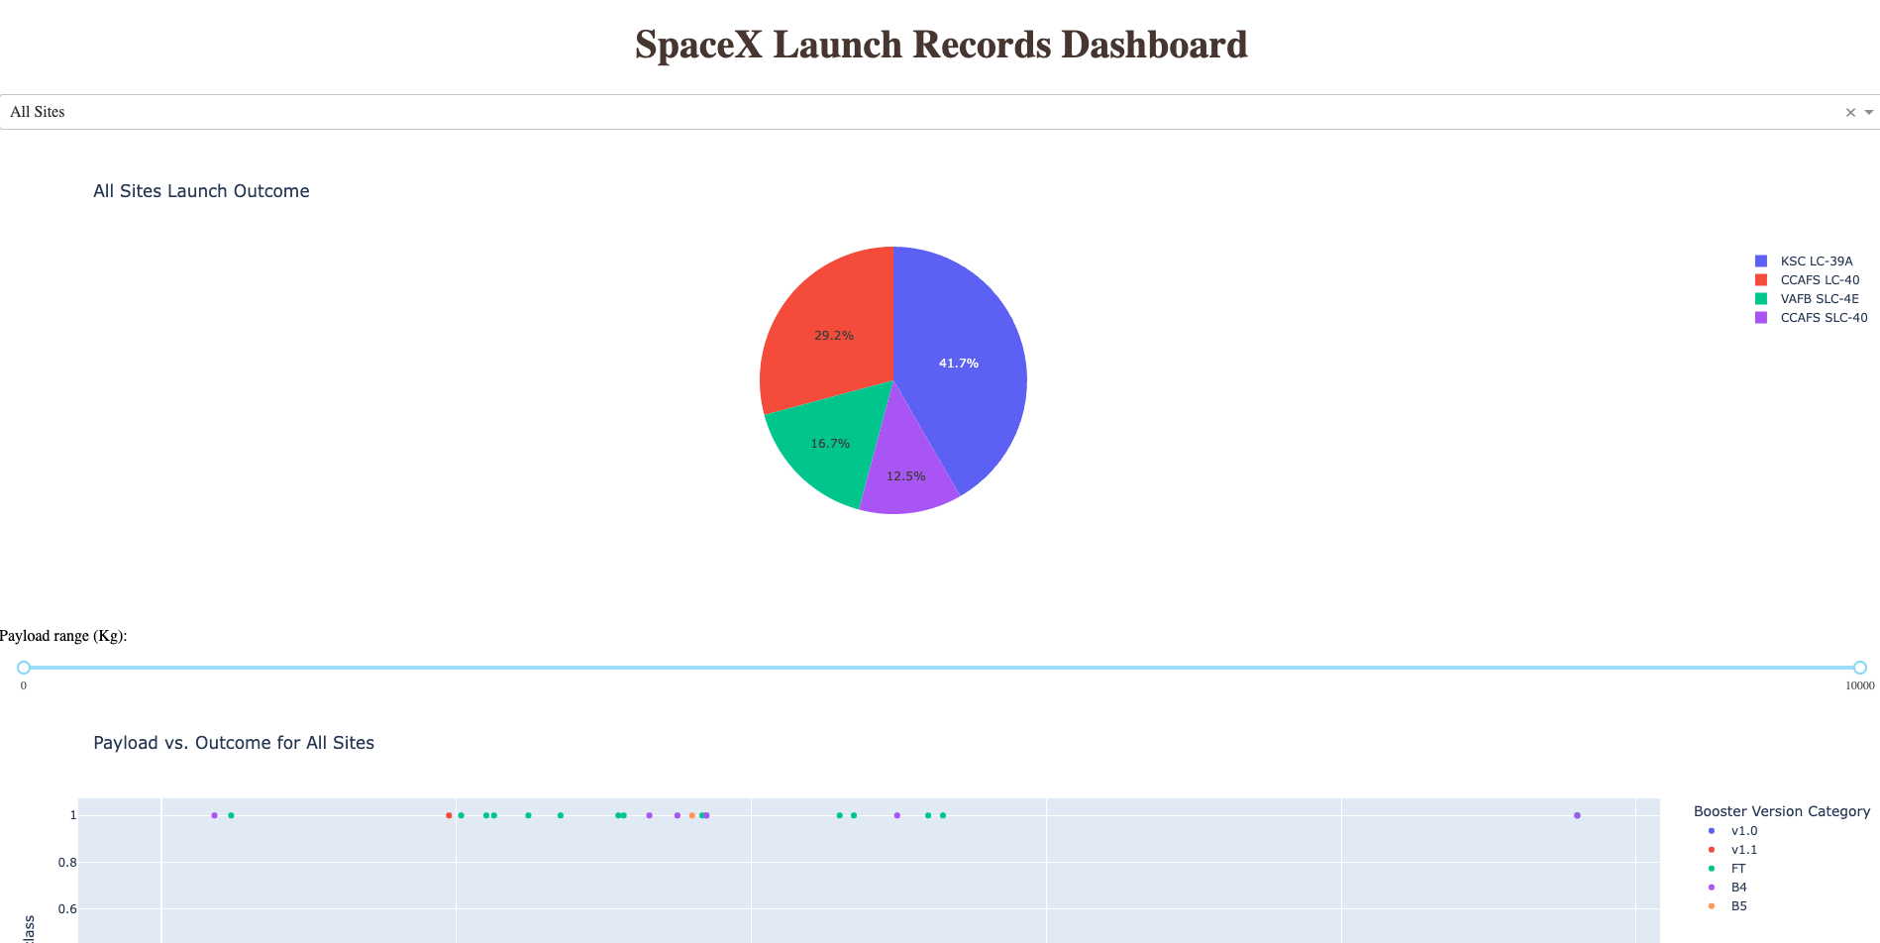
Results
Exploratory data analysis results
Launch success rate is going up over the years and peaked in 2019.
First successful landing happened in Dec 2015
Interactive analytics demo in screenshots
Screenshots demo on the right.
Predictive analysis results
The best perfoming model is decision tree because it has the best confusion matrix since true positive and true nagative is balanced with the best performing out of sample accuracy of 83.3%

Slide 16

Section 2

Slide 17
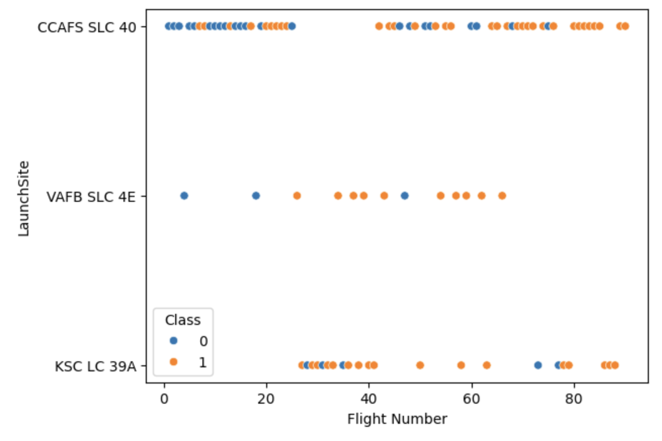
Flight Number vs. Launch Site
As I can see, higher flight number is showing more successes
VAFB SLC 4E launch site does not have any flight numbers higher than 65

Slide 18
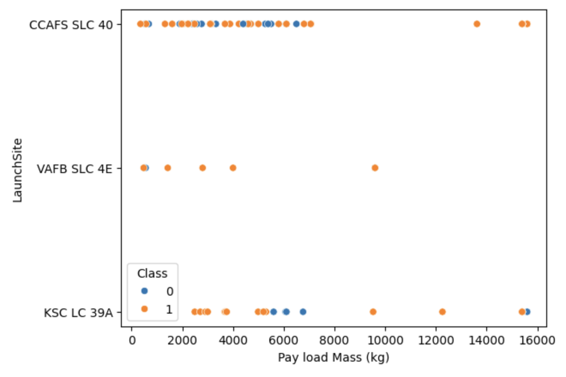
Payload vs. Launch Site
Most pay load mass are pretty low
There is no clear correlation with payload mass and success rate as I can see
Again VAFB SLC 4E does not have much data here and they do not have any higher than 10000kg payload mass launches

Slide 19
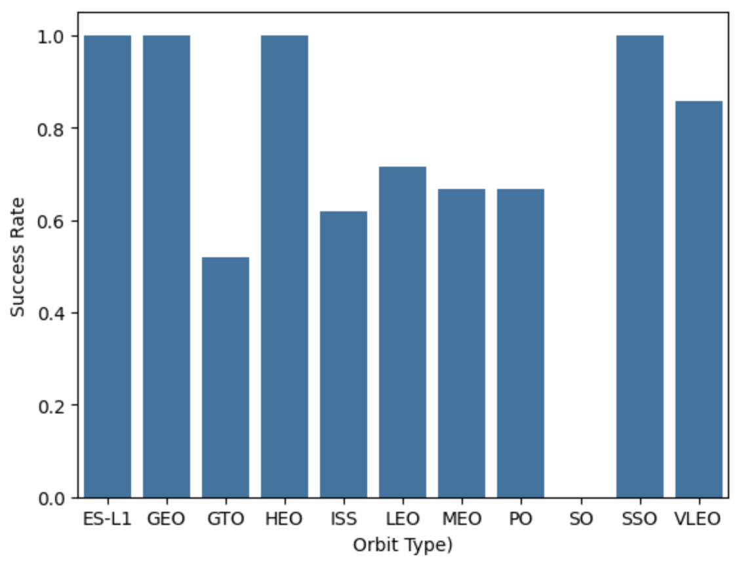
Success Rate vs. Orbit Type
GTO and SO has the lowest success rate
ES-L1, GEO, HEO, and SSO has 100% success rate
The main reason for the stats like this could be because these orbit type does not have much launches with them

Slide 20
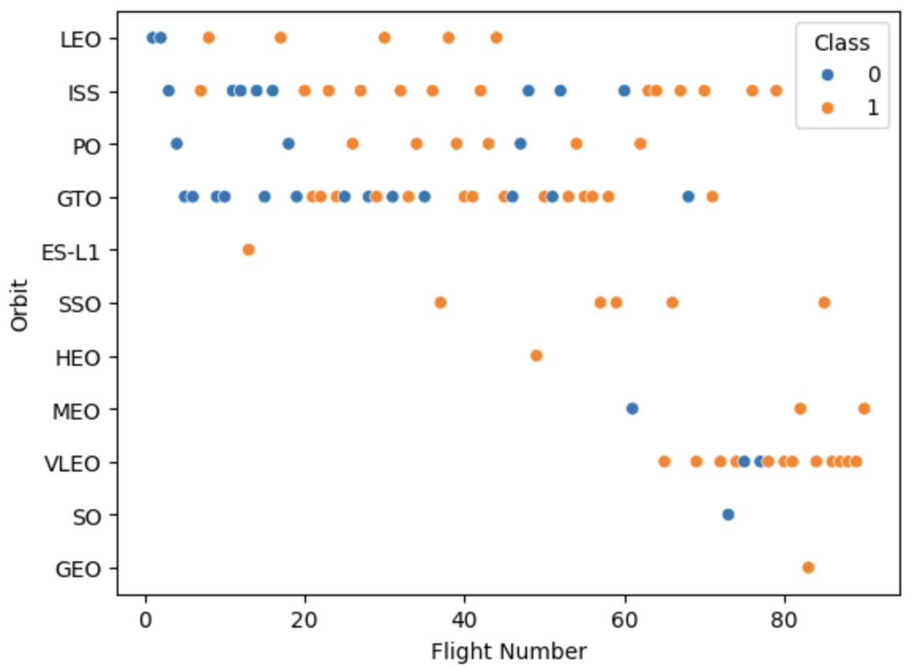
Flight Number vs. Orbit Type
ISS has launchess across all flight numbers
VLEO only has high flight number associated with it
Some of the orbit type indeed only have one launch associated

Slide 21
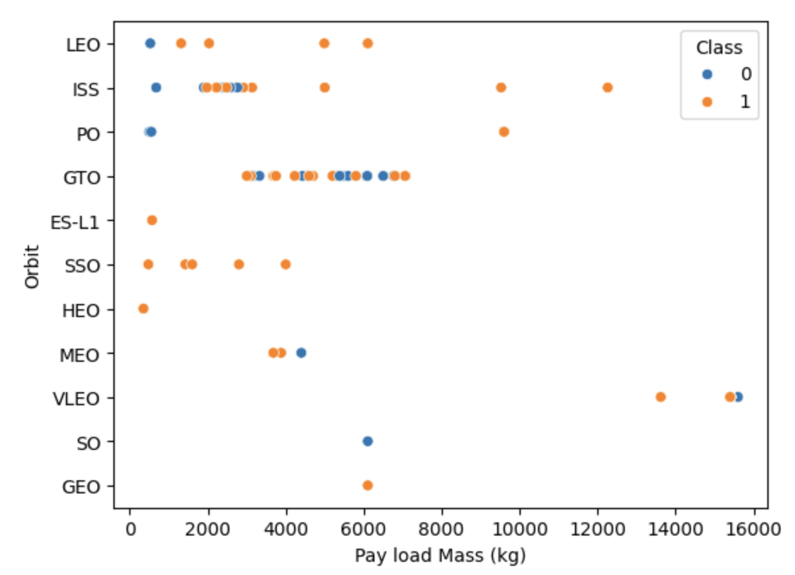
Payload vs. Orbit Type
SSO only have low payload mass associated with it and they are all succesful
Most of the launches have payload mass are lower than 8000
There is no clear visible correlation between payload mass and success rate

Slide 22
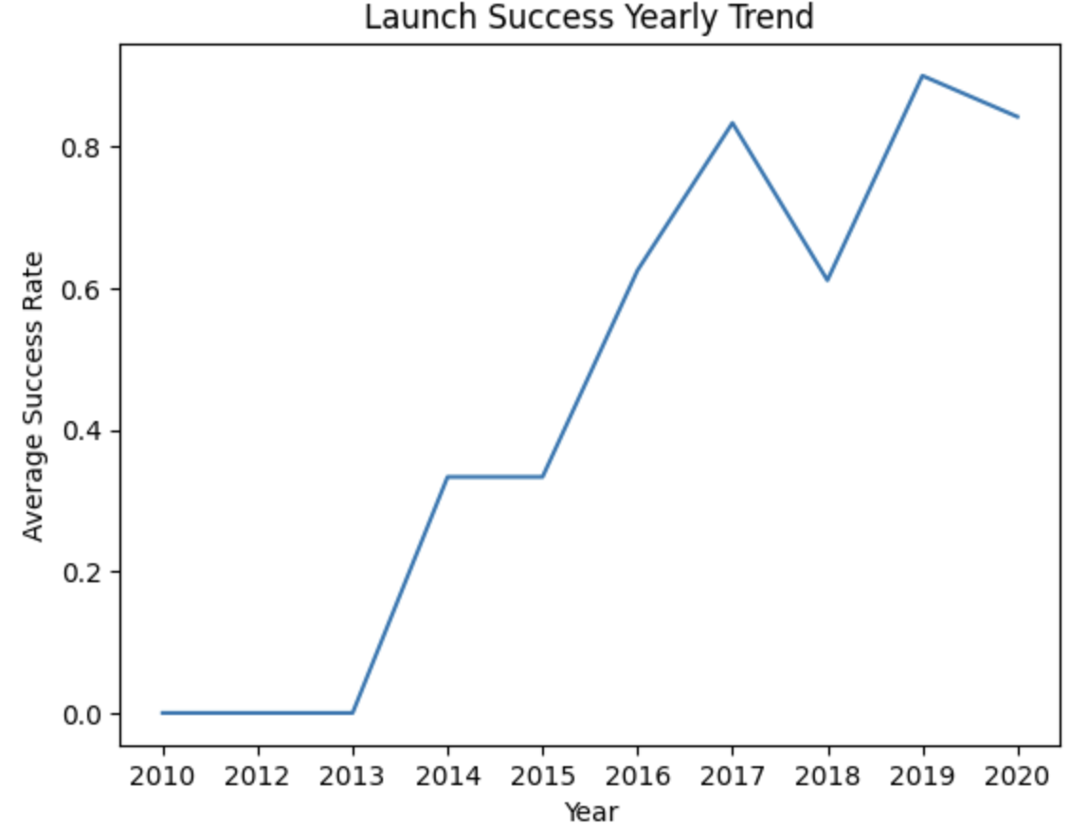
Launch Success Yearly Trend
Overall, success rate is going up
It droped down by 20% in the year 2018
It went back up even more in 2019

Slide 23
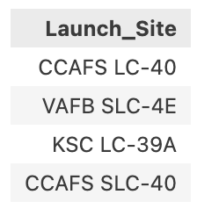
All Launch Site Names
There are only 4 different launch sites.

Slide 24
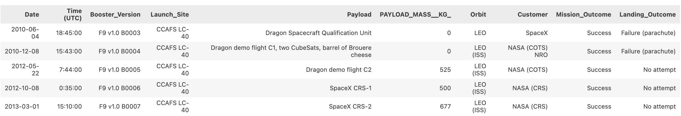
Launch Site Names Begin with 'CCA'
4 of these records were in the orbit LEO

Slide 25
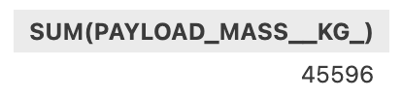
Total Payload Mass

Slide 26
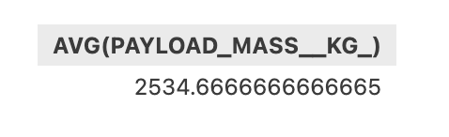
Average Payload Mass by F9 v1.1

Slide 27
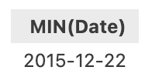
First Successful Ground Landing Date
The first succesful landing was already pretty late in time

Slide 28
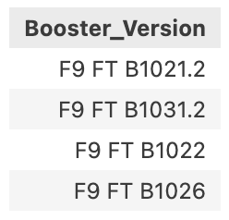
Successful Drone Ship Landing with Payload between 4000 and 6000

Slide 29
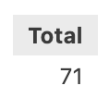
Total Number of Successful and Failure Mission Outcomes

Slide 30
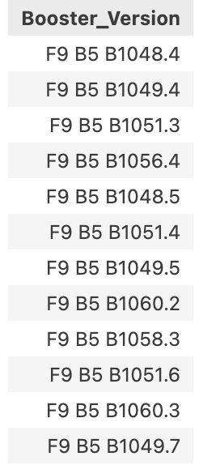
Boosters Carried Maximum Payload

Slide 31
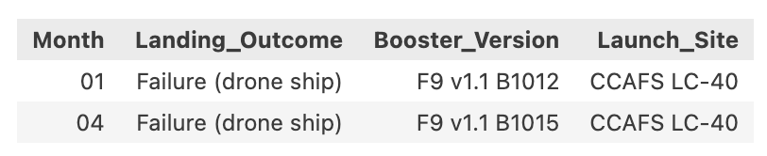
2015 Launch Records
There is only 2 records

Slide 32
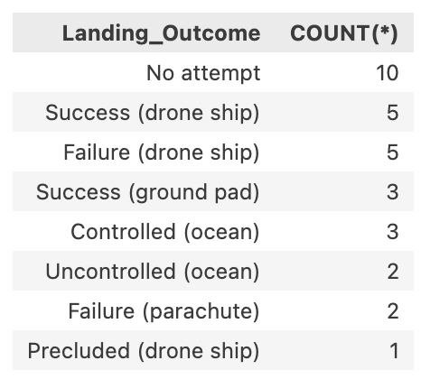
Rank Landing Outcomes Between 2010-06-04 and 2017-03-20

Slide 33

Section 3

Slide 34
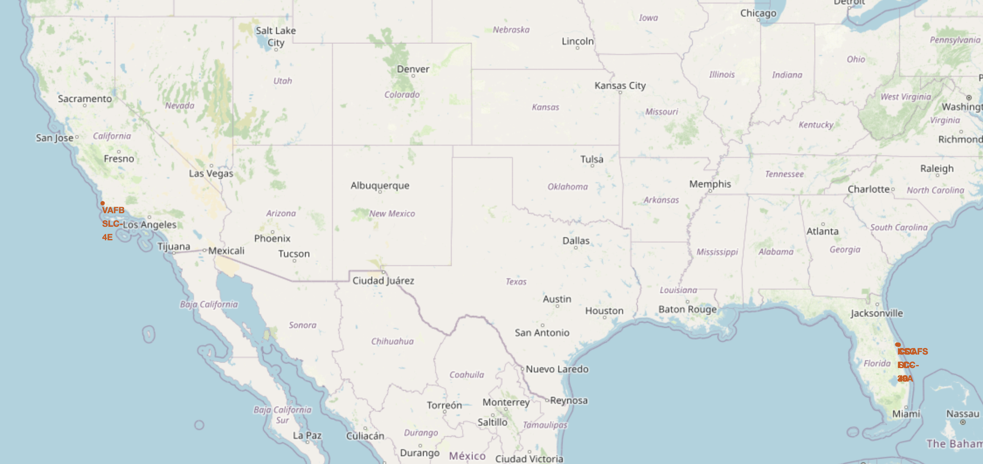
Launch Site Locations
They are all close to the coast line from the map we can see

Slide 35
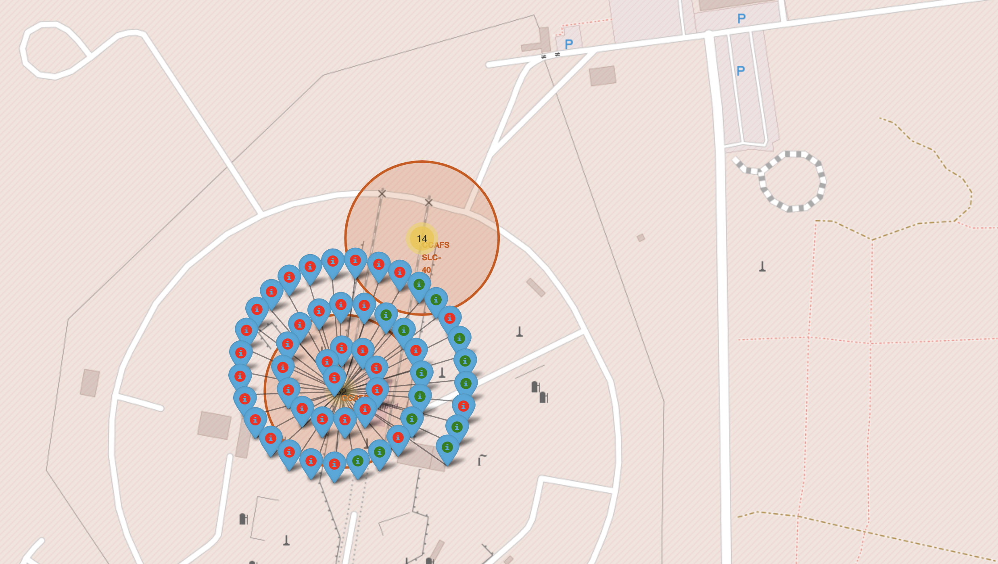
Launch Site with color labled outcomes

Slide 36
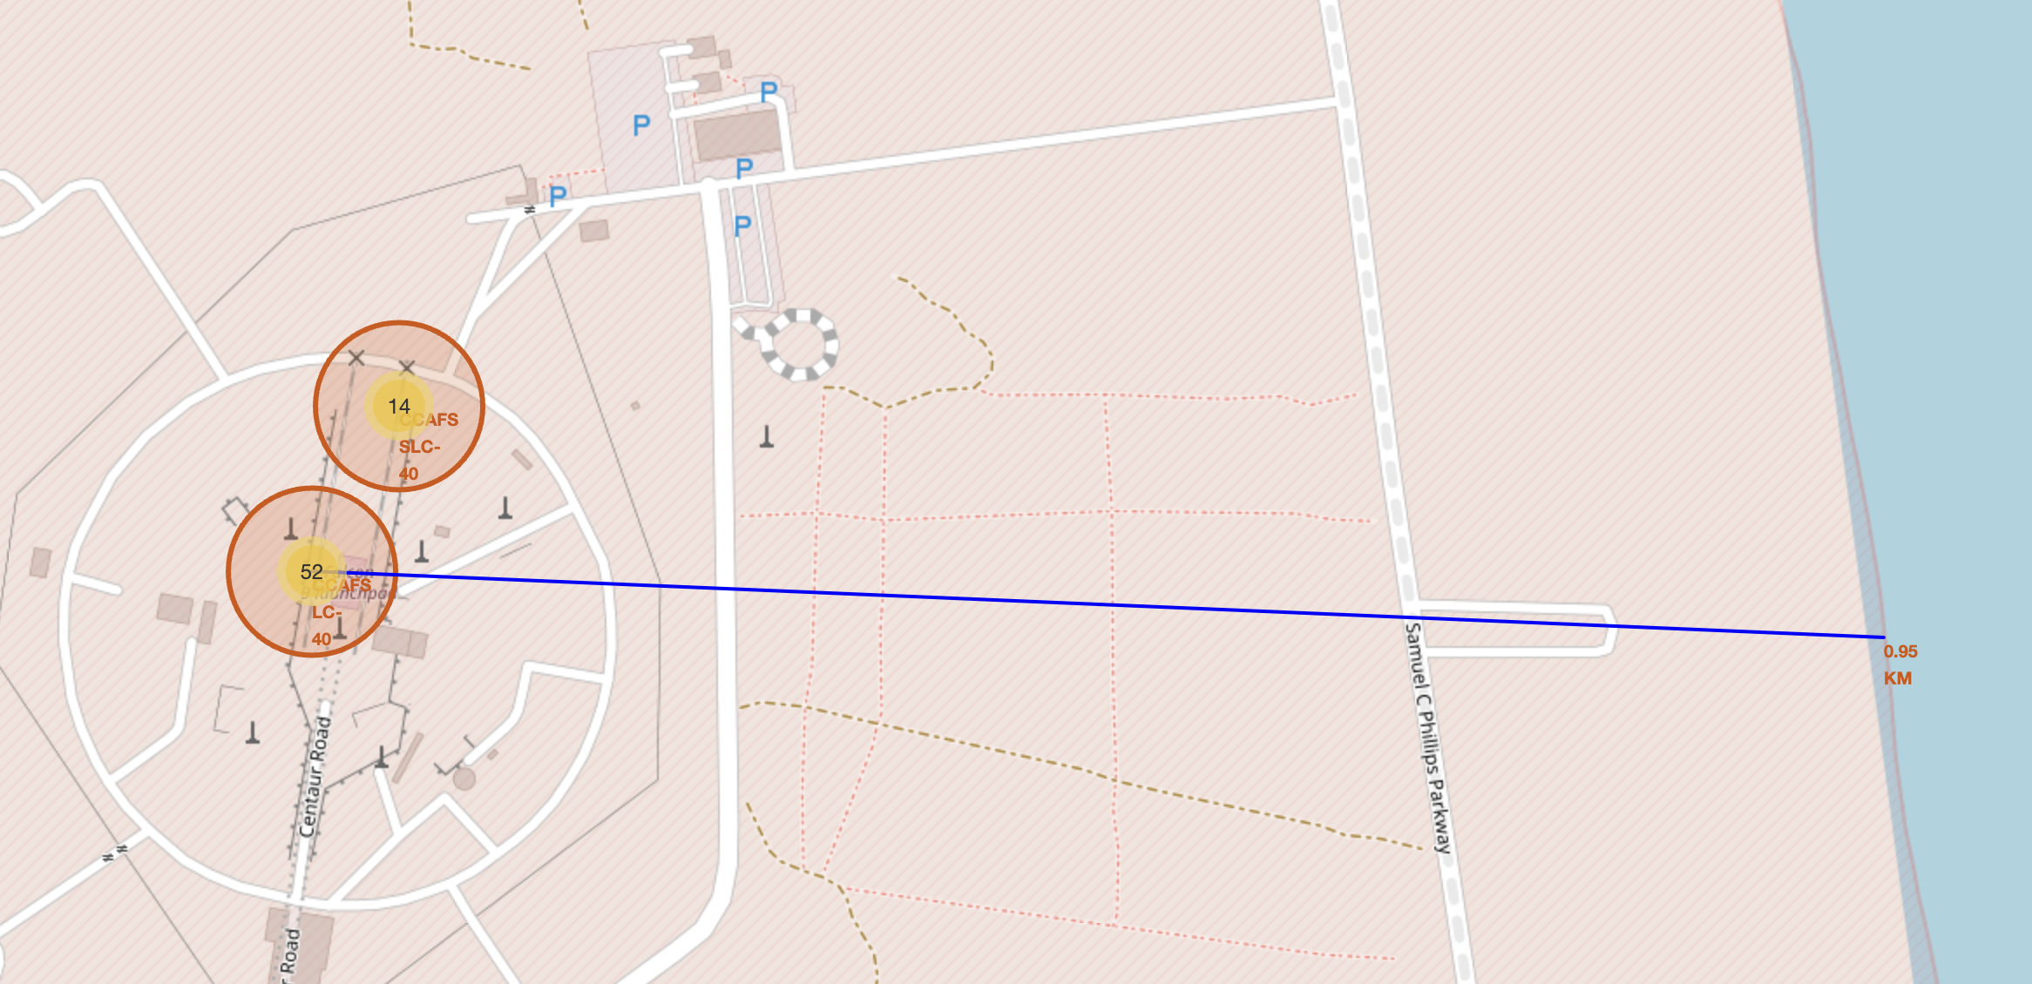
<Folium Map Screenshot 3>
It is less than 1 km from the coast line

Slide 37

Section 4

Slide 38
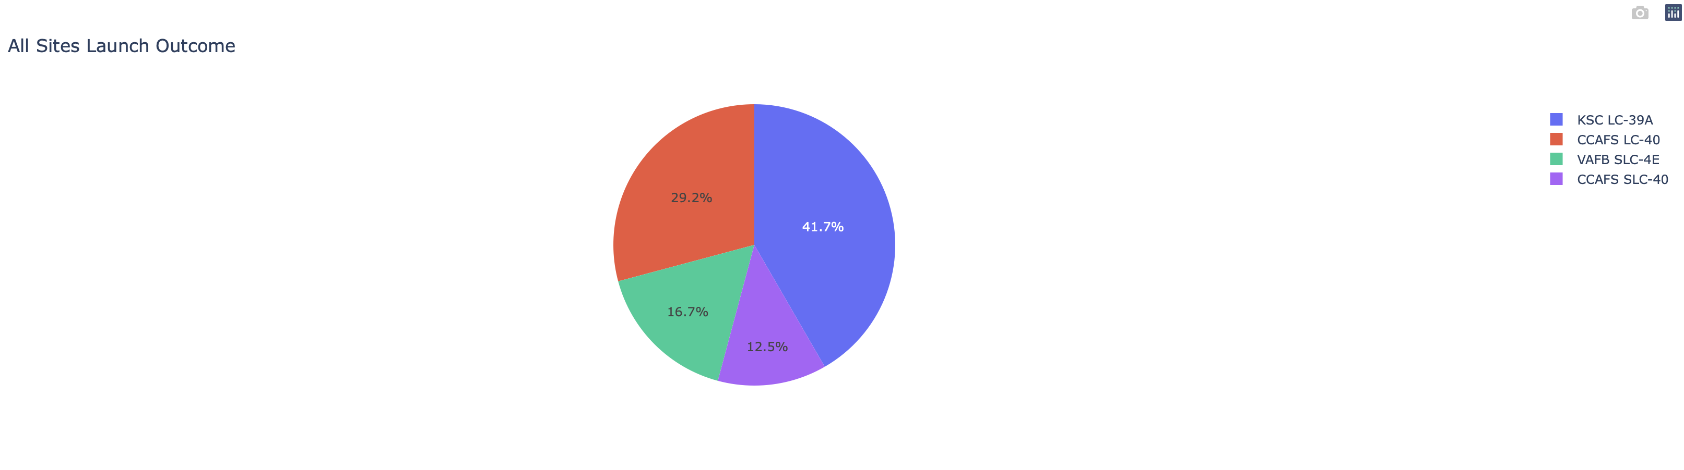
All Sites Launch Outcome
KSC LC-39A has the most succesful launches
VAFB SLC-4E has the least succesful launches

Slide 39
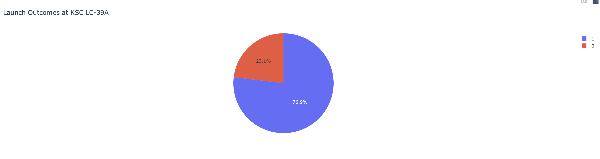
Lauch Outcome at KSC LC-39A
It has a very high 76.9% succesuful rate

Slide 40
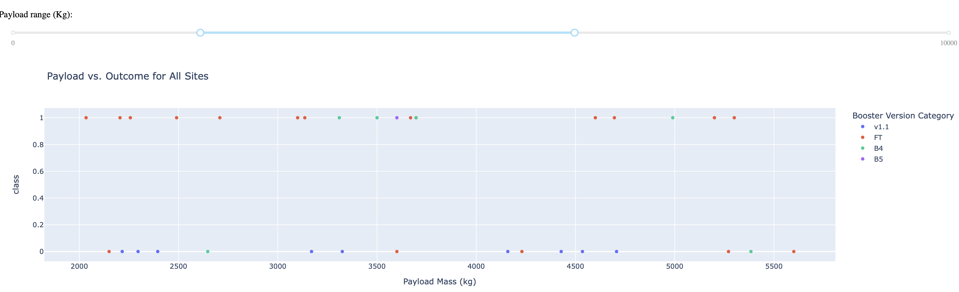
Payload vs. Outcome for All Sites (2000kg - 6000kg)

Slide 41

Section 5

Slide 42
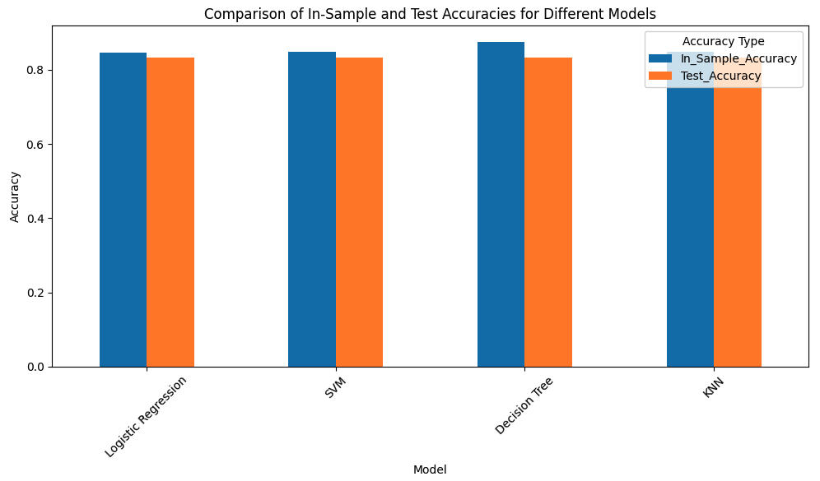
Classification Accuracy
All 4 models have the same test accuracy, however, decision tree has the highest in sample accuracy making it the best performing model

Slide 43
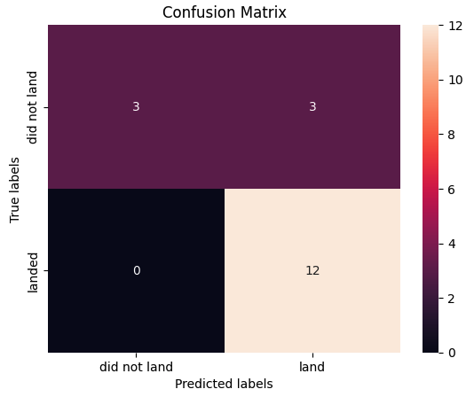
Confusion Matrix
Decision tree has the perfect predicition of landed outcomes
However it had 3 instances where it predicted land when the true out come is did not land
Resulting that it has 3 False Positives

Slide 44
Conclusions
I succesfully used API and webscraping to collect data that I need
I found out that SpaceX success rate is going up over the years through EDA
There are 4 launch sites that Space X is using where they are all very close to coast line
I was able to find a good Decision Tree model with 84% in samle accuracy and 83% test accuracy that can effectively predict the launch outcomes

Slide 45
Appendix
I do not have any appendix.

Slide 46


